Slide 1

Beyond the Buzz AI & the Next Generation Workforce
How AI can modernize your workforce strategy in the energy sector
Morgan Jones, Founder — G‑Data Labs CEWD The Summit • November 19, 2025
Responsible & Ethical AI for Energy

Slide 2
Agenda
0–5 min: Welcome & context
5–15 min: Gen Z workforce gap & challenges
15–30 min: AI adoption & its impact
30–45 min: Demonstrations of G‑Data tools
45–55 min: Designing your first AI pilot
55–60 min: Roadmap, call to action & Q&A

Slide 3
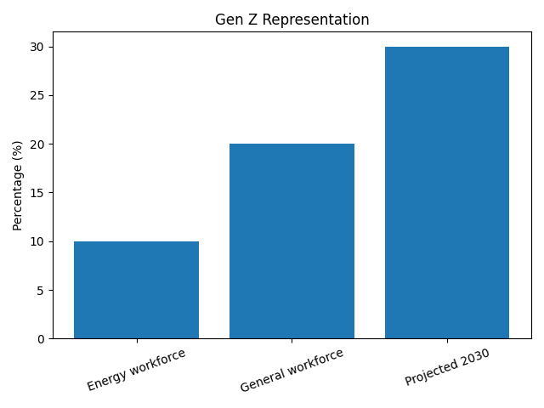
The Gen Z Workforce Gap
Fewer than 1 in 5 Gen Z are aware of energy career paths
Only about 10% of the sector’s workforce is Gen Z vs 20% across society
Gen Z will be 30% of the population by 2030—urgency to engage
Outreach must speak their language and leverage modern tools
[1]

Slide 4
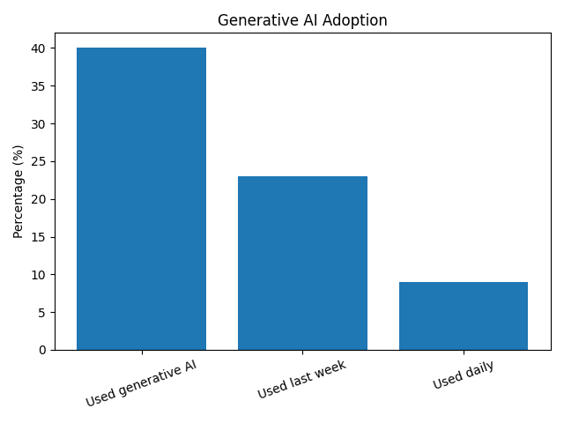
AI Adoption & Workforce Evolution
≈40% of US adults (18–64) use generative AI
23% used it last week; 9% use it daily
1–5% of work hours assisted → 1.4% time savings
AI‑driven training boosts learning efficiency by 57%
E‑learning market expected to reach $44.6B by 2028
[2] [4]

Slide 5

AI Transforming the Energy Sector
Predicts blackouts & optimizes grid operations
Enhances efficiency by analysing sensor & meter data
Integrates renewable energy sources seamlessly
Delivers predictive maintenance & improves safety
Reduces reliance on fossil fuels & boosts resilience
[3]

Slide 6

AI in Action: G‑Data Demonstrations
AI Video Training Turn manuals into engaging micro‑lessons in minutes.
AI Podcast Convert safety briefings into compelling audio.
AI Chat Assistant 24/7 career coach & Q&A built on ethical data consent.
[4] [5]

Slide 7
Design Your First AI Pilot
Define Identify a workforce pain point or training gap.
Design Choose your AI tool (video, podcast, chat, predictive) & plan.
Deploy Launch ethically with feedback loops & measure impact.

Slide 8
AI Literacy Pathway for Energy
Tier 1: Awareness & Safety Build AI literacy & safe practices for all staff.
Tier 2: Application Hands‑on training & deployment for workforce teams.
Tier 3: Innovation Labs Co‑create new solutions with leaders & educators.
[6] [7]

Slide 9
Join Us in Building the Future
Host an AI Literacy Lab or Energy + AI Experience Zone
Partner in our AI Workforce Pilot Challenge
Get a complimentary AI Readiness Assessment
“AI won’t take your job – someone fluent in it will.” Let’s make sure your teams speak that language.
Learn more at g-datalabs.com or reach out after the session.
[6] [7]

